Slide 1
Disclaimer
This training resource was developed to be used with the CZ ID platform
In October, 2026, stewardship of CZ ID transitioned to UCSF and the platform was renamed to SeqtoID
These training materials are not being actively maintained and may not reflect differences between CZ ID and SeqtoID, subsequent changes to the platform, or current methods and best practices in metagenomic sequencing and analysis

Slide 2

Sample Report Metrics
Rapid Response – Updated Sept 2026
Notes:
Slides updated 07/02/2024

Slide 3
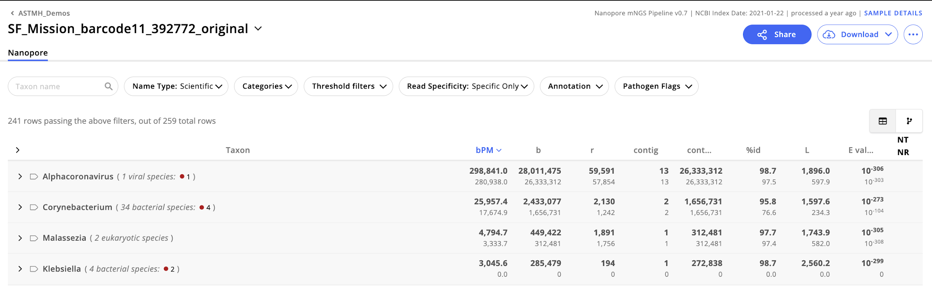
Sample Report

Slide 4
Sample Report Metrics
Bases per million (bPM): Number of bases within all the reads aligning to a given taxon, including those assembled into contigs that mapped to the taxon, per million bases sequenced
Bases (b): Number of bases within all the reads aligning to a given taxon, including those assembled into contigs that mapped to the taxon.
Reads (r): Number of reads aligning to a given taxon, including those assembled into contigs that mapped to the taxon.
Contig: Number of assembled contigs aligning to a given taxon.
Contig bases (contig b): Number of bases within all the reads that assembled into contigs aligning to a given taxon.
Percent identity (% ID): Average percent identity between all the query sequences (contigs and unassembled reads) and their matching taxon
Length (L): Average length of alignments between all the query sequences (contigs and unassembled reads) and their matching taxon (values against NR are reported in base pairs)
Notes:
No Z score

Slide 5
Sample Report: each metric shows two results (NT/NR)
NT = nucleotide database
NR = protein database
Important: Values against NR only reflect alignments between contig sequences and their matching taxon (i.e., unassembled reads are not aligned against NR).
General Interpretation Notes:
Contigs aligning to both databases: Good sign that the hit is true (more to it than that)
If a contig is viral and only has a hit to the NR database: Hit could represent a divergent virus
If a hit is bacterial and it only has a contig to the NT database: Sequences may be aligning to the 16S rRNA region, which is not in the NR databases (should not be trusted)

Slide 6
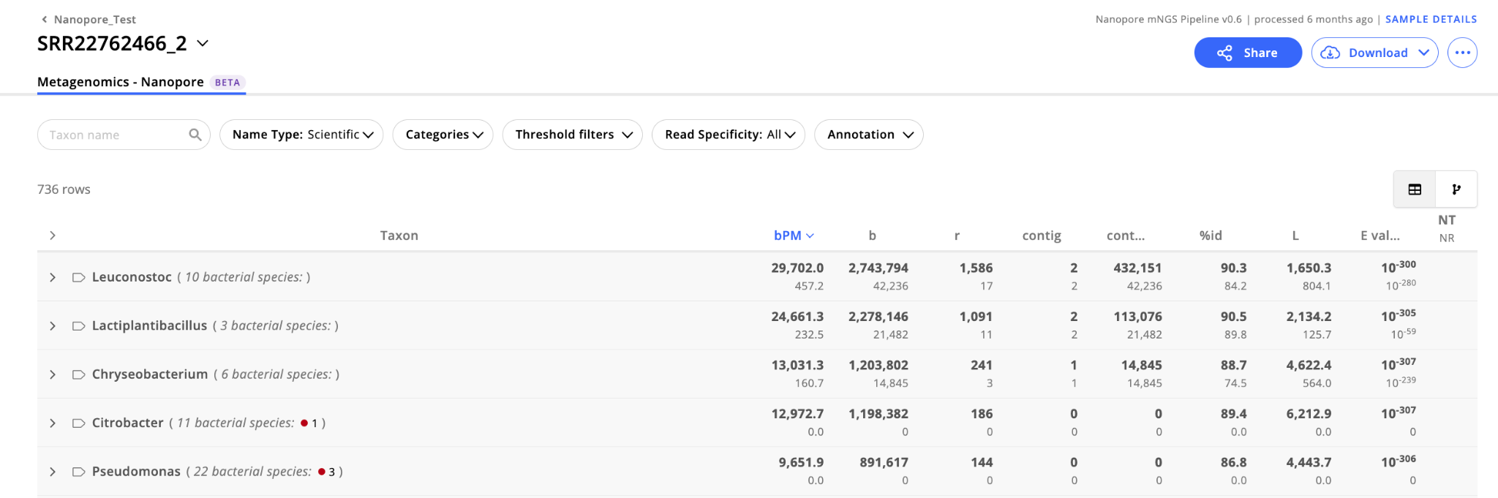
Sample Report
Important: Values against NR only reflect alignments between contig sequences and their matching taxon (i.e., unassembled reads are not aligned against NR).
No contigs = no chance for NR hit

Slide 7
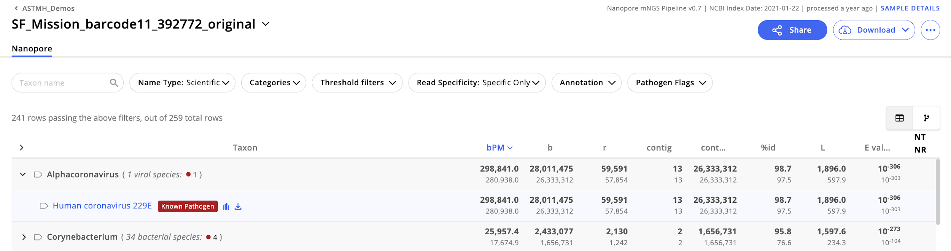
Filters are helpful at removing false hits, but not perfect
Suggested (initial) filters:
bPM NT > 100 to remove taxa that were present at low levels.
bPM NR > 1 to remove taxa that only have matches in non-coding regions
(this will only help if there are contigs)
NT L > 75 bp to remove taxa with alignments < 75 bp long
E-value (NT and NR) < 0.001 to remove likely random matches. In general, we suggest setting the E-value filter to <= 10^-10 for stringent searches or <= 0.01 to allow for less significant taxon matches.

Slide 8
Gaining confidence in taxon calls using report metrics
Metric | Definition | Interpretation
bPM | Number of bases within the reads aligning to taxon per million bases sequenced (normalized metric) | Higher bPM = more confidence in the hit
Bases (b) | Number of bases wthin the reads aligning to taxon | Higher b = more confidence in the hit
Reads (r) | Number of reads aligning to taxon | Higher r = more confidence in the hit
Contig | Number of assembled contigs aligning to taxon | Longer contig = more confidence
Contig r | Number of reads aligning to assembled contigs | Higher Contig r = more confidence
% id | Average % identity of alignment to accession | Should be taken into account with other metrics
L | Average length of alignment of contigs and reads | Longer alignment = more confidence (if it’s divergent, L may not be high)
E value | Average expect value of alignment | Lower = more confidence
Notes:
High abundance doesn’t mean pathogen, but is a good place to start

Slide 9


Available Analysis Icons
Coverage visualization: Available for any taxon supported by > 1 read matching NT
Download: Option to download read or contig sequences (FASTA) associated with a given taxon

Slide 10
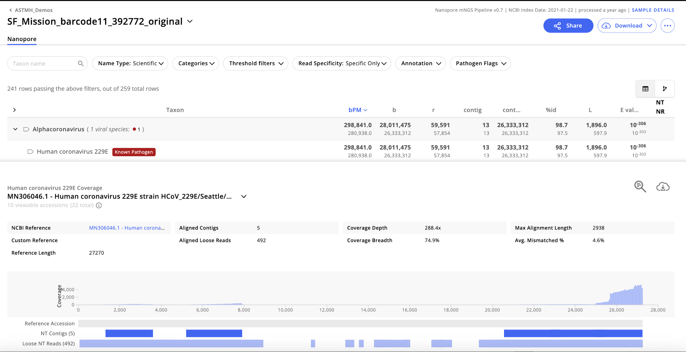


Available Analysis Icons (coverage visualization panel)
BLAST: Only available for taxa with at least one contig matching NT.
Download: Download contig sequences (FASTA).

Slide 11
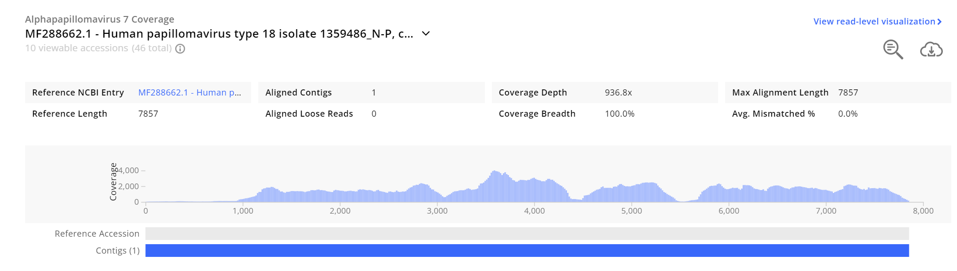
The coverage visualization is valuable for evaluating hits

Slide 12
Take into consideration the depth and breadth of the coverage (the higher, the better)
depth
breadth

Slide 13
Taking into account coverage breadth and depth
Depth | Breadth | How to Interpret
High | High | Provides you with confidence that this is a true hit!
Low | High | If there is coverage across multiple regions of the genome, this is likely a real hit. Evaluate the assembled contigs (NT L) and ensure the alignment is good (% identity).
High | Low | Depends on whether the small portion that has high coverage is unique to that particular taxon and on the quality of the alignment and assembly.
Low | Low | May be a result of genomic similarity at the 16S rRNA region (for bacteria)

Slide 14
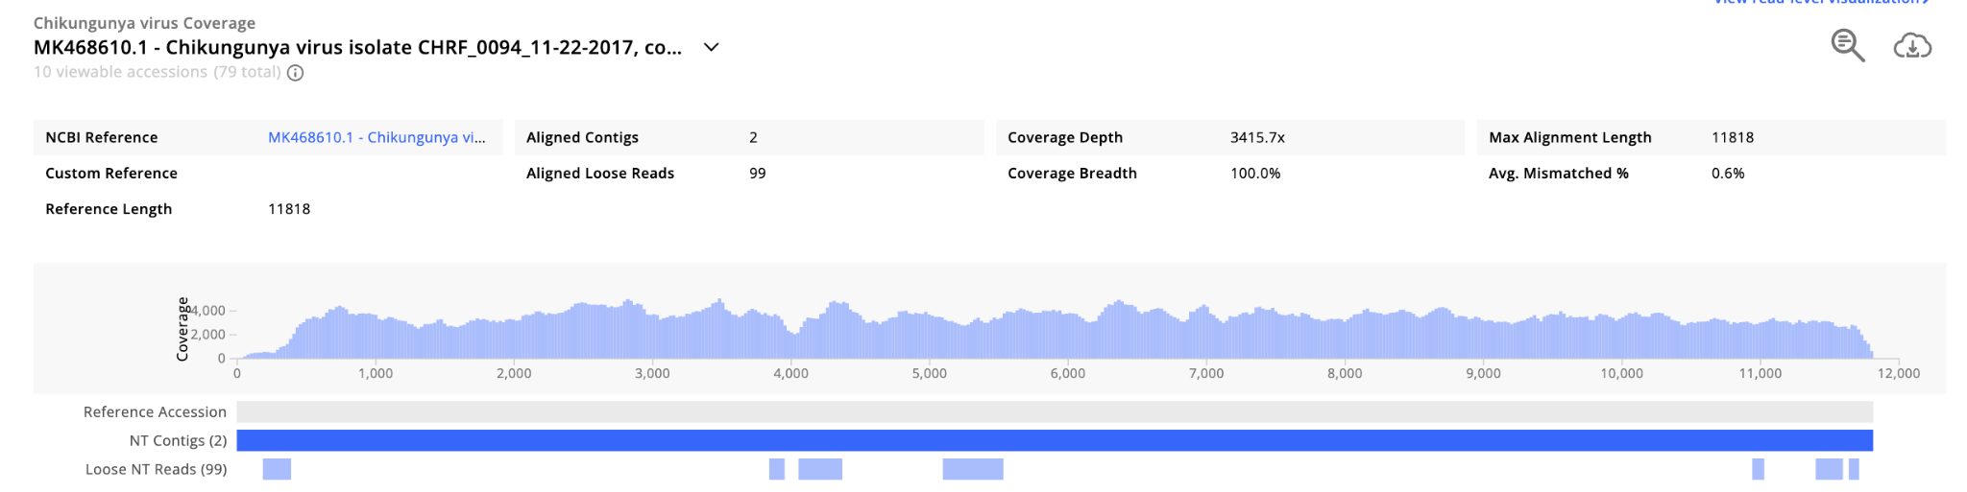
What do we think about this viral hit?

Slide 15
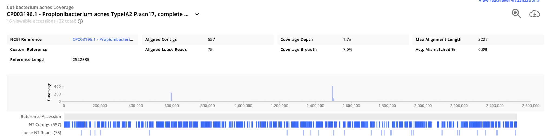
What do we think about this bacterial hit?
Notes:
Consider NT contigs and scale.

Slide 16
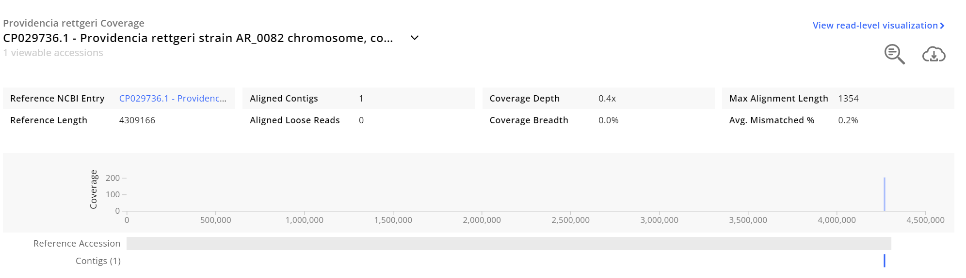
What do we think about this bacterial hit?
Notes:
Applies to all taxonomic groups.
Is this taxon interesting to our study?
Look at total reads for this sample -> low total, not surprising to have low coverage
BLAST -> specificity

Slide 17
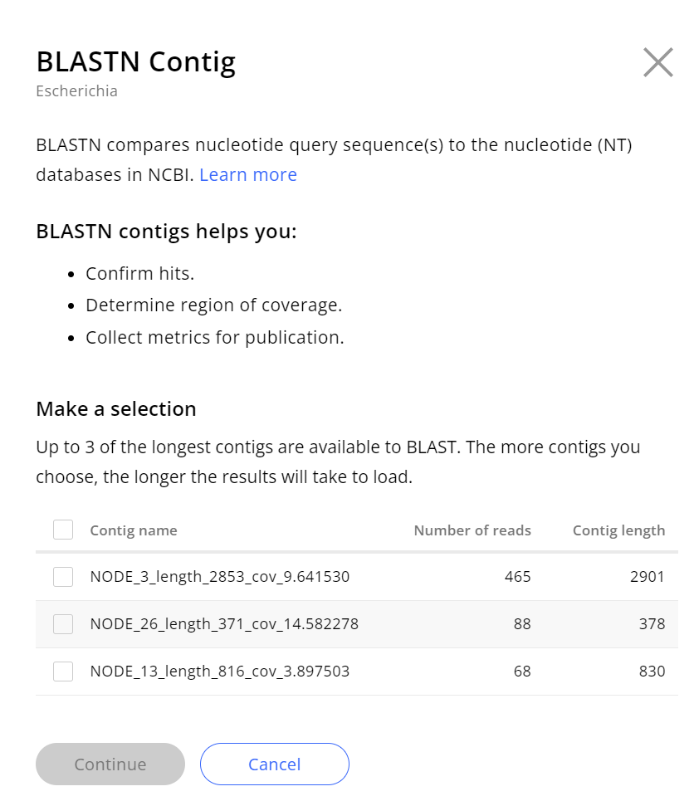
BLAST can be used for hit confirmation

Slide 18
Genome Assembly?
CZ ID’s mNGS Nanopore pipeline is meant for metagenomic analysis only (i.e., taxonomic identification)
The mNGS pipeline can be used to gather information for downstream genome assembly:
  Quickly identify organisms and/or potential reference sequences
  Download reads/contigs associated with organism of interest (FASTA)
  Download quality- and host-filtered reads (FASTQ or FASTA)

Slide 19
Let’s do our own analysis!

Slide 20
Exploring Results
QC metrics
Sample Report
  Metrics
  Analysis
Accounting for background

Slide 21
Analysis Workflow - ONT
Complete a first pass sample report view
Look at the list of detected taxa
Record NT bPM, NT r, and any other relevant metrics
Look at the coverage plot for each taxa and record your interpretation (low, medium, high coverage)
BLASTn contigs from each candidate taxa and record what you find (specific, non-specific, etc)
Check negative water controls
Navigate to the sample report for each negative water control included in the run
For each taxa observed in the samples, record the NT bPM, NT r, and any other metrics in each water control
If you have >1 water control, calculate the average signal for each taxa
Put it all together (background subtraction + interpretation)
Subtract the background/water control signal from the sample signal for each taxa
Interpret: real signal should be higher in samples than in water controls

Slide 22
Go to worksheet: Sample Report section
Worksheet: CZ ID Training Reference Tables & Worksheets_ONT, pg 10-16

